Slide 1
Hypothesis Testing & Statistical Tests
Lesson 4.3

Slide 2
Welcome
jQuery $(Begins)

Slide 3
I’m Greg Smith (6:30 – 6:35)
You’re Substitute Instructor
Web Developer Bootcamp – Normally
Over 30 years in Software Development
Including Database Development
Today
High Level Overview of…
Hypothesis Testing
Null Hypothesis
Statistical Tests

Slide 4
Intro to Hypothesis Testing
jQuery $(Begins)

Slide 5
Hypothesis Testing (6:35 – 6:40)
Hypothesis testing is a way to test a theory or question.
What are some data questions you may ask?
Does this new medication work?
Is the cost of living higher in this city?
Does this group score higher than another group?
A large part of Statistics and the Scientific Process is to identify a Hypothesis and then try to determine if the observations or effects could be due to chance.
jQuery $(Begins)

Slide 6
Hypothesis Testing (6:35 – 6:50)
An Hypothesis is a
measurable and
testable statement
about something that you expect will happen.
The Hypothesis is often expressed as an If/Then statement.
"If San Diego, CA is warmer than Austin, TX in July,
then the average daily temperature will be higher.”
The Null Hypothesis is typically stated that NO differences exist between the variables or groups of interest.
"If San Diego, CA is not warmer than Austin, TX in July,
then there will be no difference in the average daily temperatures."
jQuery $(Begins)

Slide 7
Hypothesis Testing (6:35 – 6:50)
Hypothesis Testing applies statistical methods to determine if something happened purely by chance.
Scientists and researchers often form a Hypothesis for their observations along with a Null Hypothesis.
The Null Hypothesis assumes that observations or effects are simply by chance.
The goal of hypothesis testing is to reject the Null Hypothesis through statistical tests.
Rejecting the Null Hypothesis presumes that the Hypothesis was true.
jQuery $(Begins)

Slide 8
Hypothesis Testing (6:35 – 6:50)
Rejecting the Null Hypothesis is never absolute.
Instead, statisticians calculate the probability of observing the event.
This is called the P value.
The P value is then compared to a fixed significance level to determine if the Null Hypothesis can be rejected.
A smaller P value indicates stronger evidence against the Null Hypothesis.
jQuery $(Begins)

Slide 9
Hypothesis Testing (6:35 – 6:50)
Steps for Hypothesis Testing:
Determine the Hypothesis and Null Hypothesis.
Identify the appropriate statistical test.
Determine the acceptable significance value.
Compute the P-value.
Determine if the P-value rejects the Null Hypothesis by comparing it to the significance value (Typically < 0.05).
jQuery $(Begins)

Slide 10
Partners: Forming a Null Hypothesis
jQuery $(Begins)

Slide 11
Partners: Forming a NULL Hypothesis (6:50 – 7:00pm)
Work in pairs to convert the following questions into Hypothesis and Null Hypothesis
Files: 01-ParNullHypothesis/README.md
Instructions
Convert the following Questions into
* an Hypothesis and
* a Null Hypothesis
Does Dark Chocolate affect arterial function in healthy individuals?
Does Coffee have anti-aging properties?

Slide 12
Everyone: Review the Null Hypothesis
jQuery $(Begins)

Slide 13
Review: The Null Hypothesis (7:00 – 7:05)
Call on random groups to share their answers
Does Dark Chocolate affect arterial function in healthy individuals?
Hypothesis - If dark chocolate is related to arterial function in healthy individuals, then consuming 30g of dark chocolate for 1 year will result in improved arterial function.
Null Hypothesis - If dark chocolate is not related to arterial function in healthy individuals, then consuming 30g of dark chocolate over for 1 year will show no improvement in arterial function.
Does Coffee have anti-aging properties?
Hypothesis - If coffee consumption is related to anti-aging properties, then consuming 400 mg of coffee daily will reduce mortality from age related disease such as heart disease.
Null Hypothesis - If coffee consumption is not related to anti-aging properties, then consuming 400 mg of coffee daily will not show a reduction in age related disease such as heart disease.

Slide 14
The T-Test
jQuery $(Begins)

Slide 15
The T-Test (7:05-7:15)
A common question in statistics is whether or not one group is significantly different from another group.
The set of entities under study is referred to as the population
While a subset of population is referred to as a sample.
A T-Test can be used to
compare the mean of a sample to the population (1 Sample T-Test)
or the difference between population means (Independent T-Test).
The null hypothesis assumes that the two means are equal.
Therefore, the goal of the T-Test is to reject the Null Hypothesis.

Slide 16
The T-Test (7:05-7:15)
A common question in statistics is whether or not one group is significantly different from another group.
The set of entities under study is referred to as the population
While a subset of population is referred to as a sample.
A T-Test can be used to
compare the mean of a sample to the population (1 Sample T-Test)
or the difference between population means (Independent T-Test).
The null hypothesis assumes that the two means are equal.
Therefore, the goal of the T-Test is to reject the Null Hypothesis.

Slide 17
The P-Value (Significance) (7:05-7:15)
The P-Value or ”probability value” (or significance)
for a given statistical model,
is the probability that,
when the null hypothesis is true,
the statistical summary
(such as the absolute value of the sample mean difference between two compared groups)
would be greater than or equal to the actual observed results.

Slide 18
The One-Sample T-Test (7:05-7:15)
http://localhost:8888/notebooks/7-ProjectOne/3/Activities/02-Ins_TTest/Solved/Ins_1samp_ttest.ipynb
One Sample T-Tests are used to compare the sample mean to the population mean.
The pvalue of the first example is not statistically significant
assuming a significance of pvalue < 0.05.
# T-Test Output:
Ttest_1sampResult(statistic=-0.912976906342992, pvalue=0.36235943886051503) (pvalue is > 0.05, so it’s not significant)
The second dataset has a larger difference in means which results in a statistically significant pvalue.
# T-Test Output:
Ttest_1sampResult(statistic=-31.293376800980507, pvalue=8.6800698449009275e-79) (pvalue is ~= 0.0, so it IS significant)

Slide 19
The Two-Sample T-Test (7:05-7:15)
http://localhost:8888/notebooks/7-ProjectOne/3/Activities/02-Ins_TTest/Solved/Ins_independent_ttest.ipynb
The Two Sample T-Test I used to compare two population means.
The Independent T-Test can be used to compare the means of two populations.
The two groups (populations) should be independent from each other (i.e. a test subject in one group could not be in the second group).
The underlying assumptions for this test are independence, normality, and homogeneity.
The scipy.stats.ttest_ind function is used to perform the calculations.
The parameter equal_var=False performs a Welch’s T-test which does not assume equal population variance (homogeneity).
The pvalue of 0.096 in the first example is not statistically significant assuming a p value < 0.05.
However, the second dataset has a larger difference in means which does reject the null hypothesis (p value < 0.05).

Slide 20
QUESTIONS?
jQuery $(Begins)

Slide 21
Activity: T-Test
jQuery $(Begins)

Slide 22
Student T-Test (7:15-7:30)
Use the T-Test to compare the differences in
Adult Sardine Vertebrae counts from two different locations.
http://localhost:8888/notebooks/7-ProjectOne/3/Activities/03-Stu_Sardines/Unsolved/Stu_Sardines.ipynb
Instructions
Calculate the mean for each population.
Use a T-Test to determine if there is a statistically significant difference in the number of vertebrae of Adult Sardines in Alaska vs. San Diego.
It is up to you to determine if you should use a One Sample or Independent t-test.

Slide 23
Everyone: Review T-Test
jQuery $(Begins)

Slide 24
Review T-Test (7:30-7:35)
Did the solution require a One Sample or Independent (Two Sample) T-Test?
We are comparing two independent populations, so an Independent T-Test is required.
http://localhost:8888/notebooks/7-ProjectOne/3/Activities/03-Stu_Sardines/Solved/Stu_Sardines.ipynb
The metadata indicates that location=1 corresponds to Alaska and location=6 corresponds to San Diego.
The means for both of these populations appear to be very similar.
The pvalue of 0.607 does not reject the null hypothesis.
Questions?

Slide 25
ANOVA
jQuery $(Begins)

Slide 26
ANOVA (7:35-7:45)
We often want to compare the means of more than two groups.
In the previous activity, we may be interested in knowing if any of the locations had significant differences from the other locations.
We can use an Analysis of Variance (ANOVA) test to compare more than one population.
ANOVA
* Is a test to compare the means of multiple groups.
* Assumes the Null Hypothesis that there is no difference between groups.
* Any mean that is significantly different from the rest will result in a low p-value.

Slide 27
ANOVA (7:35-7:45)
https://www.ncbi.nlm.nih.gov/pmc/articles/PMC4925378/
This paper compares 5 treatments to reduce Mosquito/Human contact.
ANOVA is applied to compare all 5 treatments for statistical significance.
ANOVA only implies a statistically significant difference between the group means,
* but further analysis has to be completed between the groups.

Slide 28
ANOVA (7:35-7:45)
http://localhost:8888/notebooks/7-ProjectOne/3/Activities/04-Ins_ANOVA/Solved/mosquito_anova.ipynb
The boxplots of each treatment indicate a difference in at least one of the treatments.
The treatments can be filtered in pandas to separate the groups
# Extract individual groups
group1 = df[df["treatment"] == 1]
group2 = df[df["treatment"] == 2]
group3 = df[df["treatment"] == 3]
group4 = df[df["treatment"] == 4]
group5 = df[df["treatment"] == 5]
The f_oneway function in scipy.stats is used to test the null hypothesis that two or more groups have the same population mean.
stats.f_oneway(group1, group2, group3, group4, group5)
The p-value of 0.00192 matches the reported p-value from the original paper.

Slide 29
ANOVA (7:35-7:45)
ANOVA only indicates that the group means are different,
but additional testing is required to compare specific groups.
There are important assumptions that must be satisfied before the p-value can be considered valid.
The following assumptions are from the scipy.stats documentation:
The samples are independent.
Each sample is from a normally distributed population.
The population standard deviations of the groups are all equal.

Slide 30
Activity: ANOVA
jQuery $(Begins)

Slide 31
ANOVA (7:45-7:55)
This activity will use ANOVA to compare the differences in Pain Threshold for people with different hair colors.
http://localhost:8888/notebooks/7-ProjectOne/3/Activities/05-Stu_ANOVA/Unsolved/hair_anova.ipynb
Perform a one-way ANOVA test
to determine if there are any significant differences in
Hair Color vs. Pain Threshold.
Create a Boxplot to show the distribution of pain tolerances for each hair color.

Slide 32
Review: ANOVA
jQuery $(Begins)

Slide 33
Review ANOVA (7:55-8:00)
http://localhost:8888/notebooks/7-ProjectOne/3/Activities/05-Stu_ANOVA/Solved/hair_anova.ipynb
The boxplot indicates that at least two of the hair color types may be significantly different than the rest.
The HairColour type is used to filter the pain measurements into separate groups.
The ANOVA calculation rejects the null hypothesis with a pvalue < 0.05.
ANOVA does not tell us which hair color types are statistically different
Only that at least one type was significantly different than the rest.

Slide 34
Chi Square Test

Slide 35
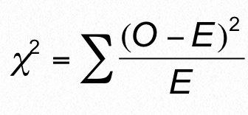
The Chi Square Test Formula (8:00-8:15)
Math formulas with Greek symbols can look intimidating.
But the idea is simple, and we’ll walk through what everything here means.

Slide 36
What is it used for? (8:00-8:15)
To answer the question: Is the distribution of frequencies in the dataset meaningful?
In other words, does the data match our expectations?
In still other words, do we accept or reject the null hypothesis?

Slide 37

Example (8:00-8:15)
Out of 300 dinosaurs,
220 eat everything
55 eat only meat
25 eat only plants
Null hypothesis: no statistical significance exists in the distribution of omnivores, carnivores, and herbivores. That is, this data can be explained by random distribution.
The chi square test can help us accept or reject the null hypothesis.
http://localhost:8888/notebooks/7-ProjectOne/3/Activities/06-Ins_Chi_Square/Solved/Ins-Chi_square.ipynb

Slide 38
Chi square test formula (8:00-8:15)
Σ (sigma): the sum of…
O: observed values:
220 omnivores
55 carnivores
25 herbivores
E: expected values (in randomly distributed data):
100 omnivores
100 carnivores
100 herbivores

Slide 39
Chi square test example (8:00-8:15)
χ² = (220-100)²/100 + (55-100)²/100 + (25-100)²/100
= 144 + 20.25 + 56.25
= 220.5

Slide 40
Steps (8:00-8:15)
Determine chi square value
Determine degree of freedom
3. Choose a p-value
4. Determine critical value
5. Make a decision

Slide 41
Degrees of freedom (8:00-8:15)
To determine the degree of freedom, take the number of rows and subtract one:
omnivores: 220
carnivores: 55
herbivores: 25
There are three rows. So the degree of freedom is 3-1 = 2.
The degree of freedom is the number of figures required to fill out the table (like Sudoku).
If we have two of the numbers, we can figure out the value of the third.

Slide 42
Steps (8:00-8:15)
Determine chi square value
Determine degree of freedom
3. Choose a p-value
4. Determine critical value
5. Make a decision

Slide 43
P-value (8:00-8:15)
The confidence level, i.e. acceptable risk of a false positive.
p = 0.05 is widely accepted in academia; may be higher in business settings.
We’ll say 0.05 in this example.

Slide 44
Steps (8:00-8:15)
Determine chi square value
Determine degree of freedom
3. Choose a p-value
4. Determine critical value
5. Make a decision

Slide 45
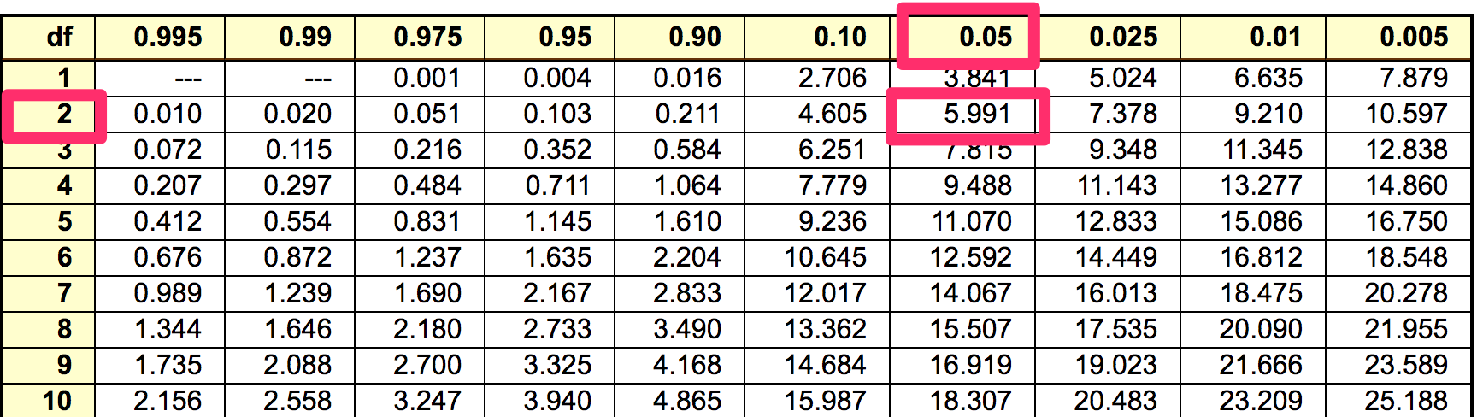
Critical value (8:00-8:15)
Found by consulting a table:
df = 2
P = 0.05
Critical value = 5.991

Slide 46
Steps (8:00-8:15)
Determine chi square value
Determine degree of freedom
3. Choose a p-value
4. Determine critical value
5. Make a decision

Slide 47
Making a decision (8:00-8:15)
The calculated chi square value is 220.5
The critical value is 5.991
Since the chi square exceeds the critical value,
we decide that the difference between
observed values and expected values
are statistically significant.

Slide 48

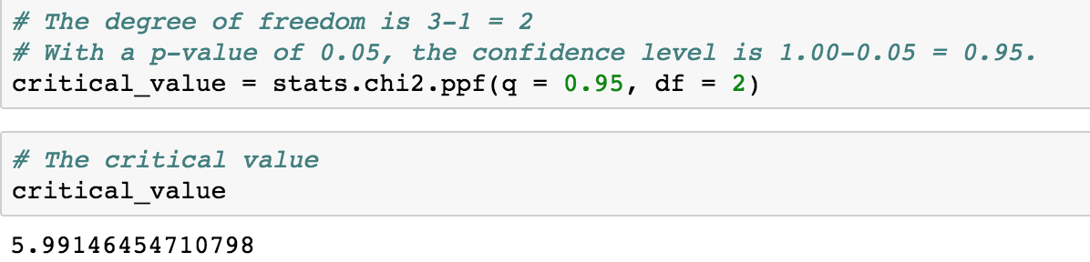
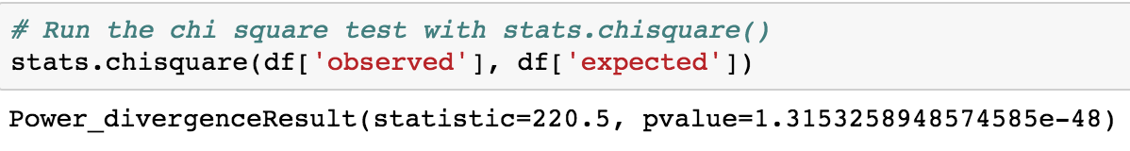
In Python… (8:00-8:15)
Import the scipy.stats module
2. Determine the critical value
3. Run the chi-square test

Slide 49
A few more considerations (8:00-8:15)
Chi square test is used to test categorical variables.
It cannot be used on continuous data.
The categories must be mutually exclusive.
We have covered using the chi square to test goodness of fit.
It can also be used to test independence. (Feel free to explore this on your own. Not hard.)

Slide 50
Activity: Chi Square
jQuery $(Begins)

Slide 51
Review ANOVA (8:15-8:25)
http://localhost:8888/edit/7-ProjectOne/3/Activities/07-Stu_Chi_Square/README.md
http://localhost:8888/notebooks/7-ProjectOne/3/Activities/07-Stu_Chi_Square/Unsolved/Stu-Cafes.ipynb
Perform the chi-square test:
first with Python
then by hand.

Slide 52
Review: Chi Square
jQuery $(Begins)

Slide 53
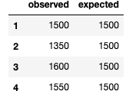
Review Chi Square (8:25-8:30)
http://localhost:8888/notebooks/7-ProjectOne/3/Activities/07-Stu_Chi_Square/Solved/Stu-Cafes.ipynb
In this case, the null hypothesis would be that there is no statistical difference in the number of visits to each of the four cafés.
Since the total number of visits to all four cafés is 6,000, the expected number for each café is 6000/4, or 1,500.
The expected column is added to the data frame.

Slide 54
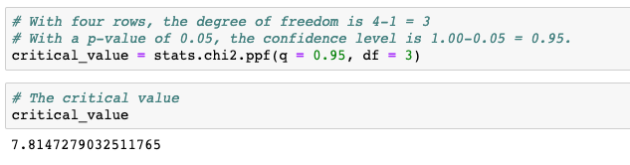
Review Chi Square (8:25-8:30)
Determine the critical value.
stats.chi2.ppf() is used to establish the value in Python.
The p-value is 0.05, so the confidence level is 0.95.
The degree of freedom is 3.
There are four rows of variables (cafés),
and only the values of three of them
are necessary to determine the values of all rows.

Slide 55
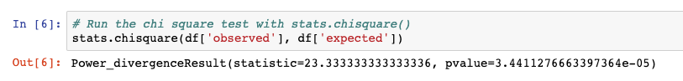
Review Chi Square (8:25-8:30)
Finally, compare the chi-square value to the critical value.
Use stats.chisquare();
its first argument should be the observed values,
and second the expected values.
Compare the chi-square value against the critical value.
Since 23.3 is greater than the critical value of 7.8,
we can conclude that the differences in the number of café visits
are statistically significant.

Slide 56
Questions?
jQuery $(Begins)

Slide 57
That’s All
Now: PROJECT TIME

